Slide 1
Sect 5.3 Graphing Sine and Cosine Functions with Horizontal Exp or Compression
© Copyright all rights reserved to Homework depot: www.BCMath.ca

Slide 2
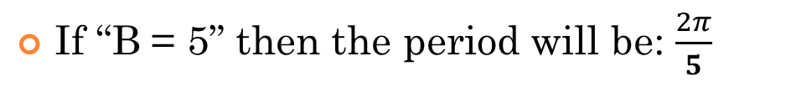

Horizontal Compression “B”
The period of a $y=sin∅$ and $y=cos∅$ [when B = 1] is $2π$
Constant “B” – Horizontal Expansion or Compression – changes the period
If “B = 3” then the period will be: $\frac{2π}{3}$
If “B = 5” then the period will be: $\frac{2π}{5}$
If the constant “B” is written as a fraction in terms of $2π$, then the denominator “p” will the “PERIOD”!!

Slide 3
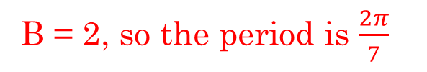

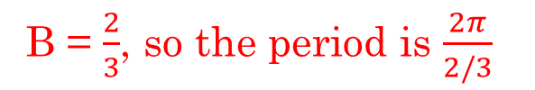

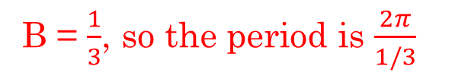
Ex: Given each function, indicate the value of “B” and the period
B = 2, so the period is $\frac{2π}{7}$
B = $\frac{1}{3}$, so the period is $\frac{2π}{1/3}$
which is equal to$6π$
B = $\frac{2}{3}$, so the period is $\frac{2π}{2/3}$
which is equal to$3π$
Solve for “p”

Slide 4
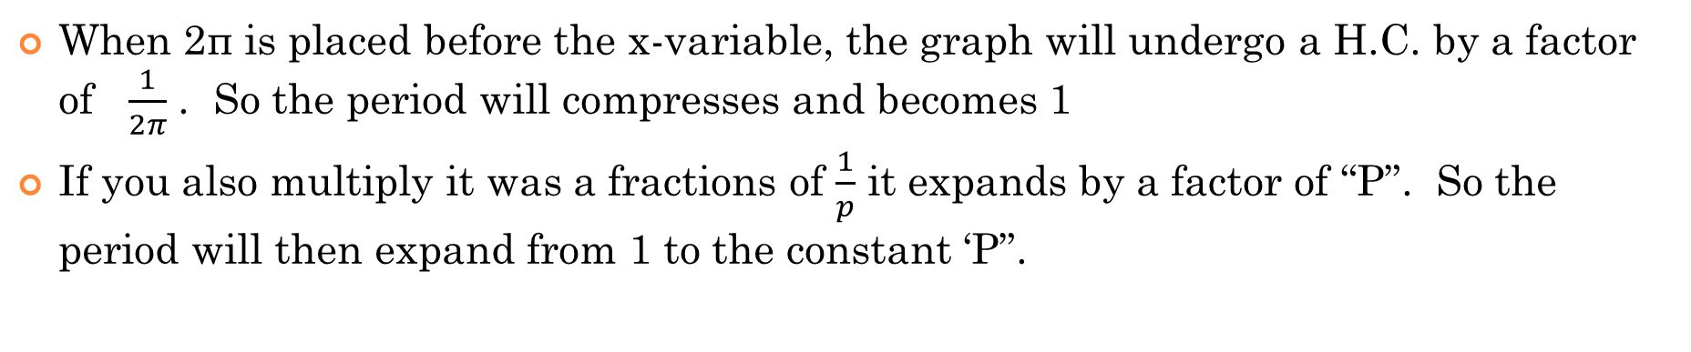
II) Why $\frac{2π}{p}$ WORKS??
When 2π is placed before the x-variable, the graph will undergo a H.C. by a factor of $\frac{1}{2π}$ . So the period will compresses and becomes 1
If you also multiply it was a fractions of $\frac{1}{p}$ it expands by a factor of “P”. So the period will then expand from 1 to the constant ‘P”.
1
0.5
x
1
2
3
π
4
5
6
2π
-0.5
-1
© Copyright all rights reserved to Homework depot: www.BCMath.ca

Slide 5
Instructions for Graphing Sine/COsine Functions:
Find the vertical displacement “D” and draw the center line
Use the amplitude to draw the Maximum horizontal line and Minimum horizontal line
Use the horizontal displacement “C” to find where the function will start
From where you begin your graph, use the period “p” to map out the length of one cycle and where it ends. Cut the cycle into 4 sub-domains
For Sine functions, start at the Center
For Cosine Functions, start at the TOP
Unless there’s a vertical reflection → Upside down
© Copyright all rights reserved to Homework depot: www.BCMath.ca

Slide 6
Ex: Find A, B, C, D, indicate the Period and Amplitude. Then graph 2 cycles of the function
Repeat the cycle to the left and right
y
2
1
x
−0.5π
0
0.5π
π
1.5π
2π
2.5π
-1
-2
-3
-4
-5
-6
-7
-8
-9
© Copyright all rights reserved to Homework depot: www.BCMath.ca

Slide 7
Graphing Sine/Cosine with Horizontal Reflections
Cosine Functions are “Even” functions, the graph doesn’t change after a Horizontal Reflection: $f\left(x\right)=f(−x)$
So a cosine function with “B” negative will have:
A cosine function with a HR will be the same graph without the HR
Sine Functions are “ODD” functions, a Hor. Reflection. is the same as a Vertical Reflection: $f\left(−x\right)=−f(x)$
So a Sine function with “B” negative will have:
A sine function with a HR will be the same graph with a VR!! Note: V shift DOES NOT change!!

Slide 8
Practice: Indicate the values of A, B, C, and “D”, and then find the following: a) Graph the function with the grid provided,
b) Indicate the period
c) Find all the x-intercepts
This is a cosine function with a HR.
A cosine function with a HR is the same as a cosine function without the HR!!! So we can just graph:
This is a sine function with a HR, it is the same as a ssine function replaced with a VR!!! So we can just graph:
Simplify this equation first!

Slide 9
Ex: Find A, B, C, D, indicate the Period and Amplitude. Then graph 2 cycles of the function
Repeat the cycle to the left
y
8
6
4
2
x
−6π
−5π
−4π
−3π
−2π
−π
0
π
2π
3π
4π
5π
6π
-2
© Copyright all rights reserved to Homework depot: www.BCMath.ca

Slide 10
Ex: Find A, B, C, D, indicate the Period and Amplitude. Then graph 2 cycles of the function
Repeat the cycle to the left and right
y
9
8
7
6
5
4
3
2
1
x
-3
-2
-1
0
1
2
3
4
5
6
7
8
9
© Copyright all rights reserved to Homework depot: www.BCMath.ca

Slide 11
Ex: Find A, B, C, D, indicate the Period and Amplitude. Then graph 3 cycles of the function
Repeat the cycle to the left and right
1
y
x
0
π
2π
-1
-2
-3
-4
-5
© Copyright all rights reserved to Homework depot: www.BCMath.ca

Slide 12
Ex: Given the following graph, which of the following is the correct equation
y
First draw the vertical displacement
6
5
4
All equations have the same
Amplitude, so don’t worry about it
3
2
1
Check the Horizontal displacement for each equation
x
−π
−0.5π
0
0.5π
π
-1
Graph starts at the top, so it can’t be a sine graph
Graph starts at the top, so it can’t be a cosine graph with a VR!
Graph should start at the bottom because
It’s a cosine graph with a vertical reflection
This is the correct function!!
© Copyright all rights reserved to Homework depot: www.BCMath.ca

Slide 13
Ex: Given that the following graph has an equation in the form of , what is the value of B ?
Draw the Vertical Displacement
Find the length of the period
Each increment is
y
6
5
4
3
2
1
x
−π
0
π
-1
© Copyright all rights reserved to Homework depot: www.BCMath.ca

Slide 14
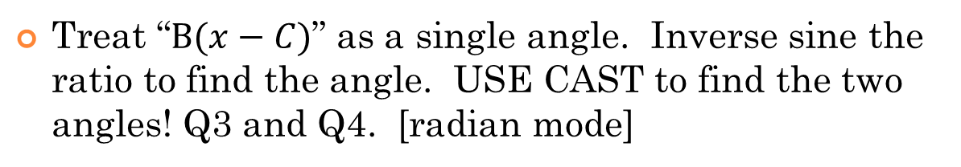
Finding the “x” intercepts with Horizontal Compression
First find the value of “B” and find the period:
The equation has a horizontal compression by a factor of ½ . So between 0 and 2pi, there will be 4 X-intercepts!
Now make “Y” equal to zero and isolate the sine function. Subtract “D” and divide by “A”
Treat “$B(x−C)$” as a single angle. Inverse sine the ratio to find the angle. USE CAST to find the two angles! Q3 and Q4. [radian mode]

Slide 15
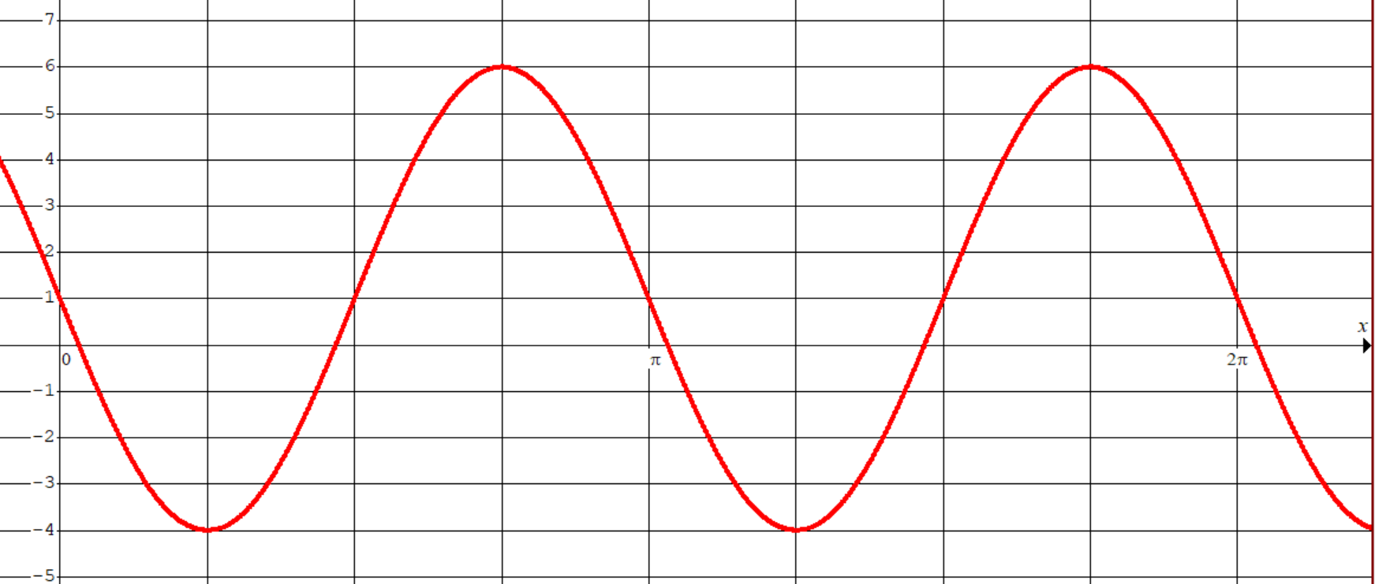
What do these two angles represent???
These numbers represent the two X-intercepts within the first cycle!
If you want to find the other 2 X-intercepts within 0 and 2π, then add the period to each of the first set of X-intercepts
Since there is a horizontal compression by a factor of ½, then there will be 2 Cycles within 0 and 2π.
This means there will be 4 X-intercepts.
Add the period to the first set of X-intercepts to get the 2nd set of X-intercepts!

Slide 16

Practice: find the “x” intercepts from 0 to 2π
Since “B=3”, there’s a Hor. Compr. by 1/3. So between 0 to 2π, we have 3 Cycles!!!
Write $3(x−\frac{π}{2})$ as a single angle. USE CAST before you solve for the angle.
These are X-intercepts in the 1st cycle!! Now add the period to get the “X” intercepts in the 2nd and 3rd cycles

Slide 17
Practice: find the “x” intercepts from 0 to 2π

Slide 18
Challenge: Given that the coordinates (m,n) is on the given sine function, then which of the following points will also be on the function?
The period of the function is:
Whenever you add/subtract the period from the a certain point, you reach the next cycle and the Y-coordinate stays consistent
To find a point that’s also on the graph, just add the
Period to the X-coordinate:
y
1
x
0
2π
4π
6π
8π
-1
© Copyright all rights reserved to Homework depot: www.BCMath.ca

Slide 19
Challenge: Given that the coordinates (m,n) is on the function y = sin(x), which of the following points will be on the function after the transformation?
V.E. by a factor of 4
Multiply the Y-coordinate by 4
H. Compression by 2
Multiply the X-coordinate by ½
H.S. of 5 units right
Add 5 to the x-coordinate
© Copyright all rights reserved to Homework depot: www.BCMath.ca

Slide 20
Challenge: Given the following graph, which of the following is the correct equation?
y
5
4
3
2
1
x
-2
-1
0
1
2
3
4
5
6
7
-1
Simplify each equation:
Find the V.D., Amplitude, Period of the graph
Graph each equation
The first equation works!!!
The second equation works!!!
The third equation also works!!!
All 3 equations will work!!!
© Copyright all rights reserved to Homework depot: www.BCMath.ca

